Slide 1
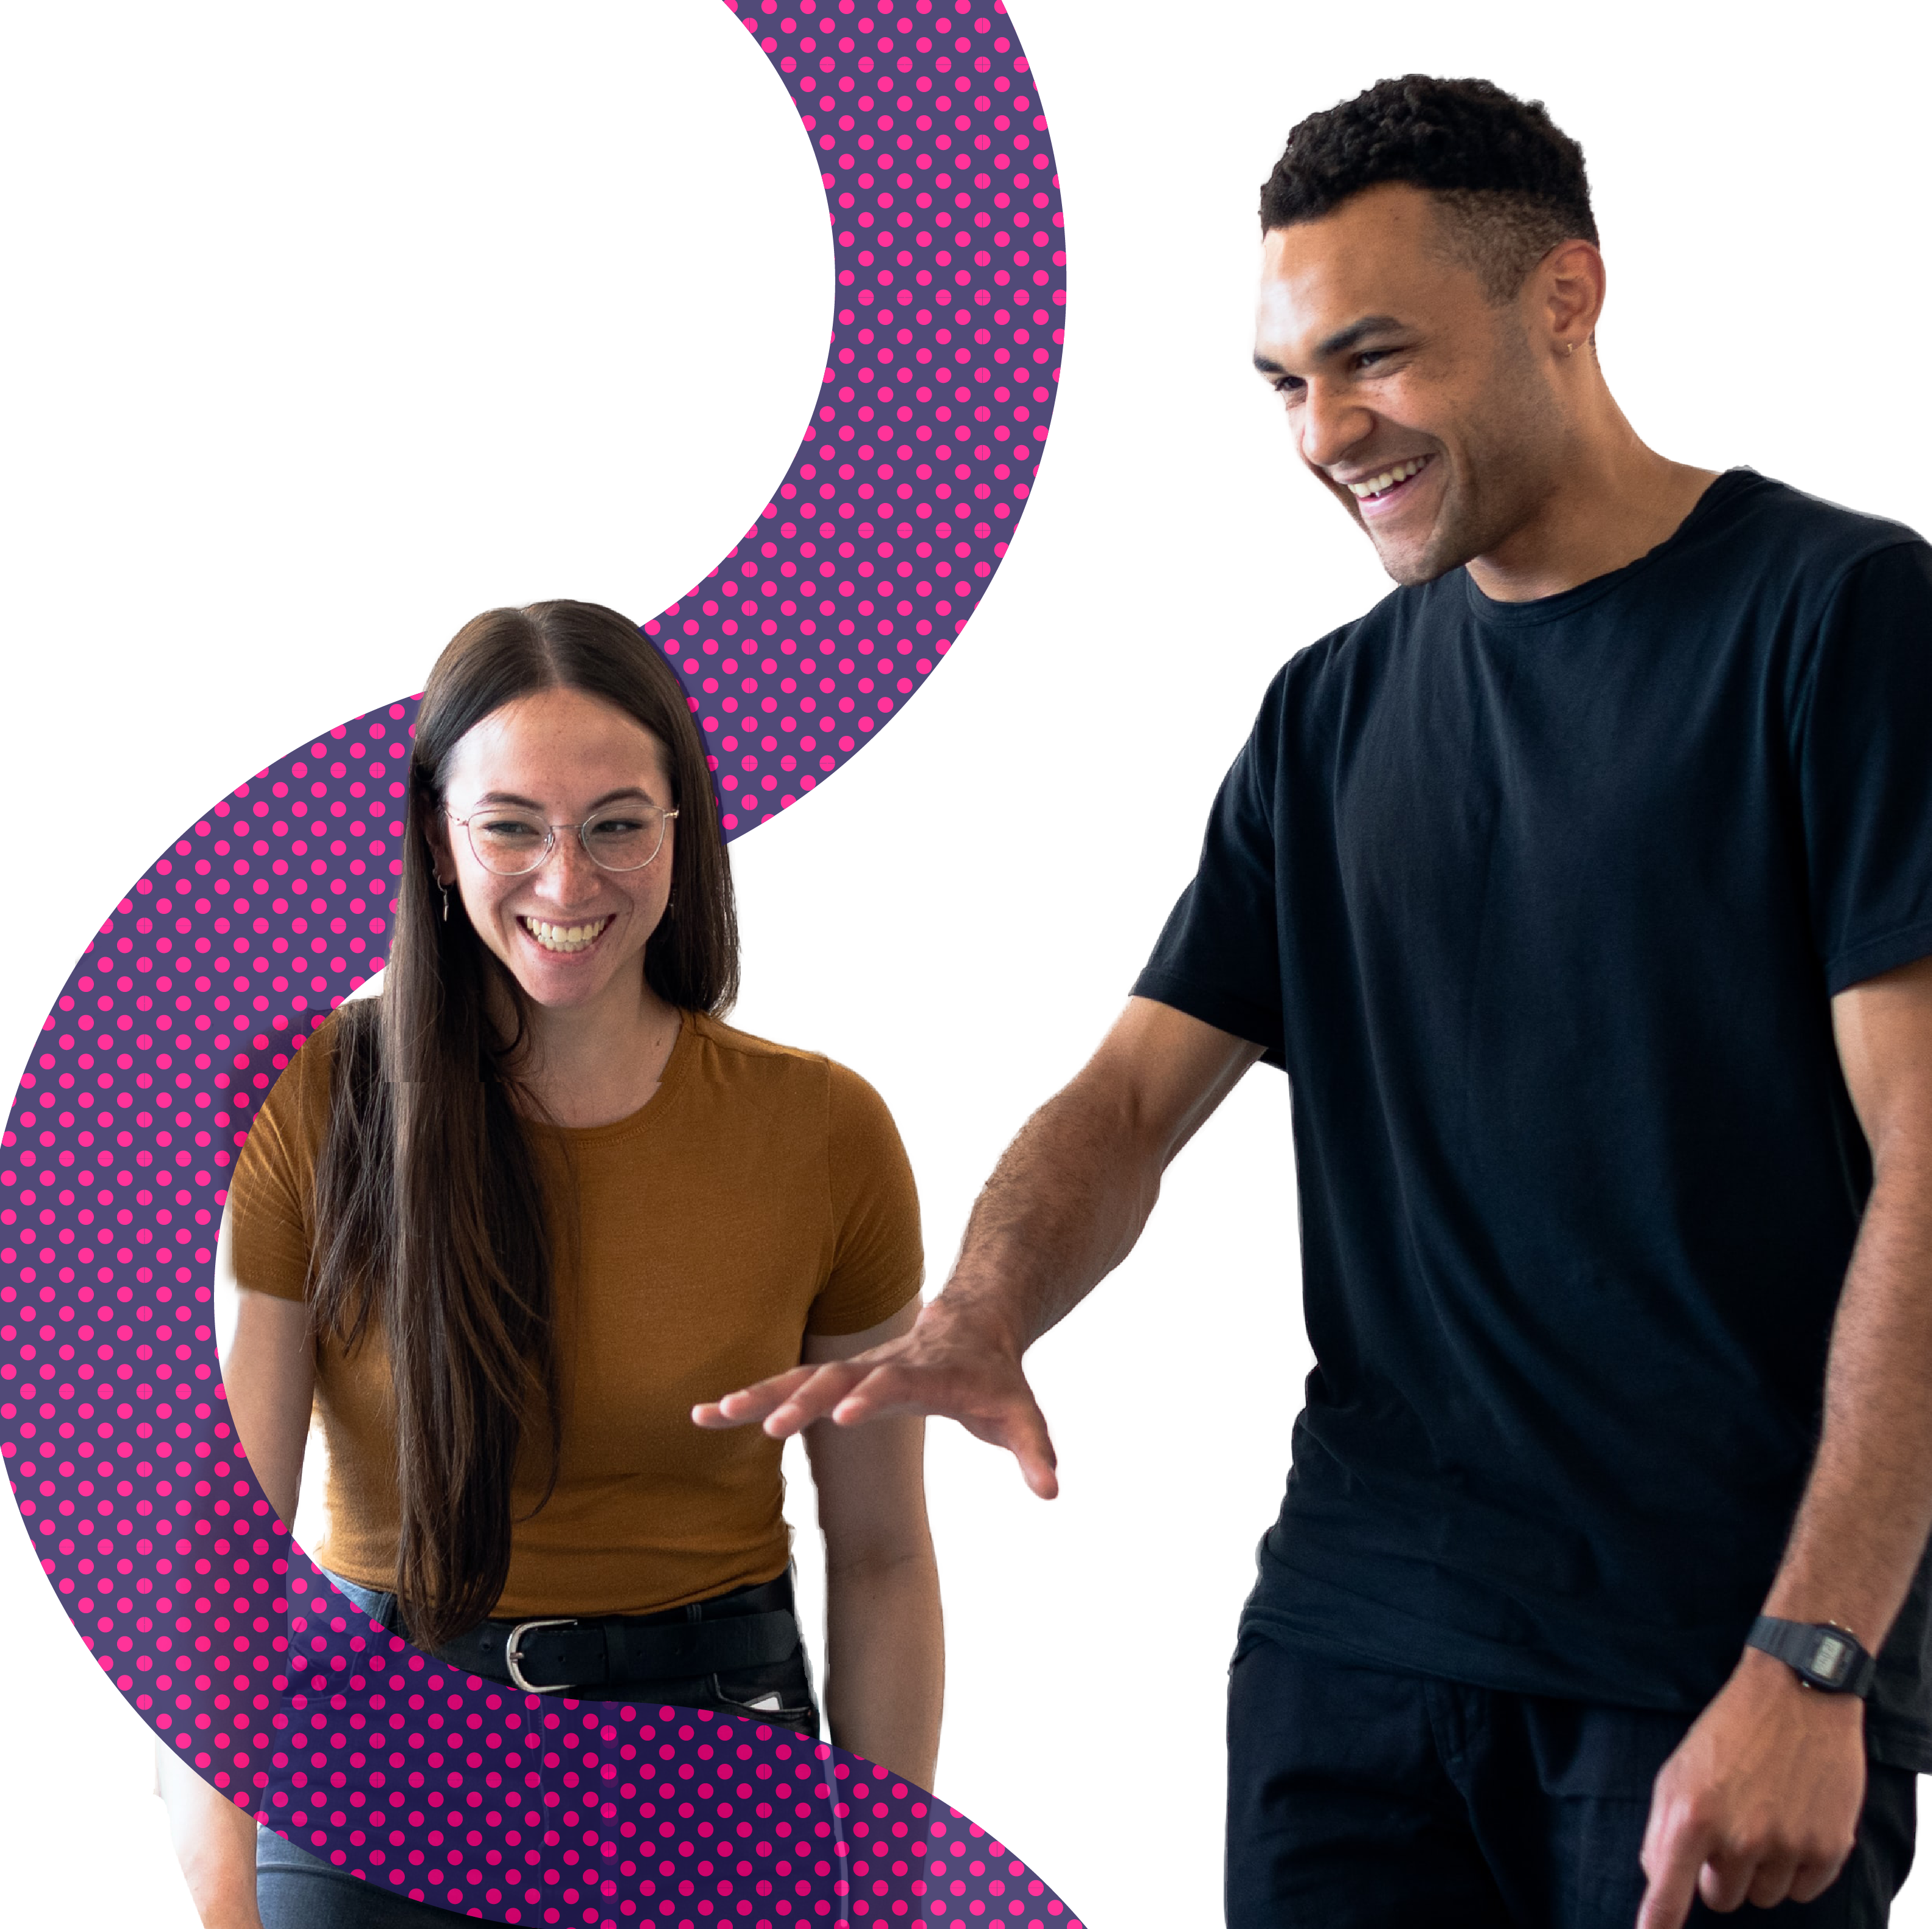
Meet real engineers

Slide 2
Scroll through to discover what engineers do, what they love about their jobs and more with Neon case studies.
Find more amazing case studies on
neonfutures.org.uk

Slide 3
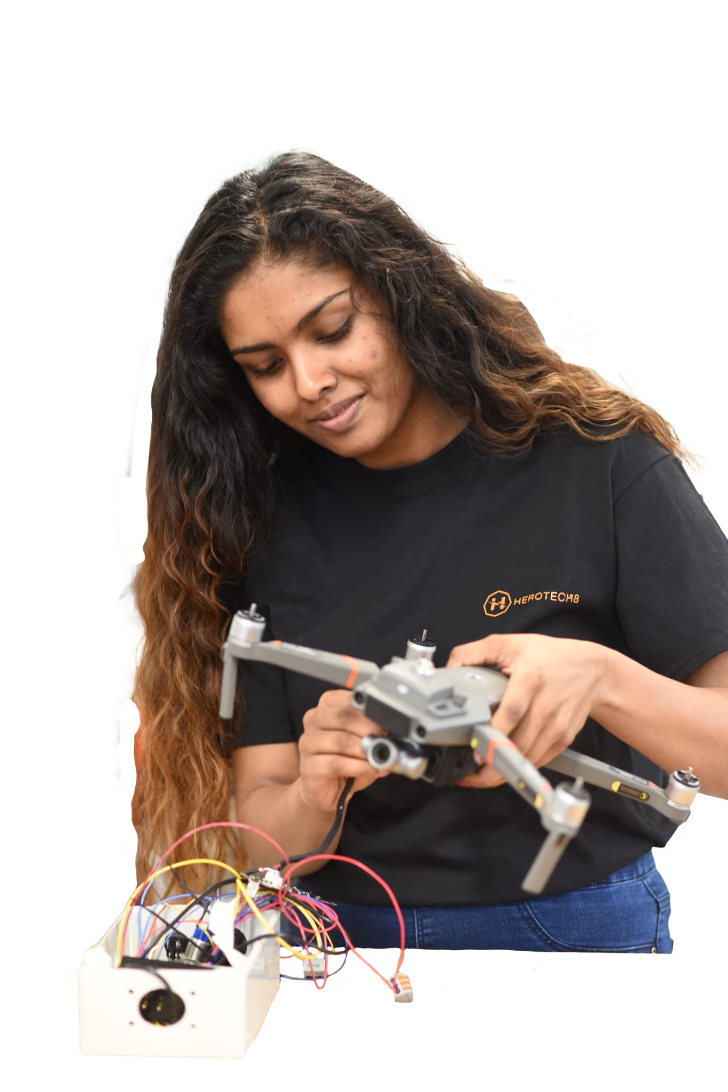
Meet Dilani
What’s your job?
I’m a drone designer – I code drones to be able to fly!
I make a difference by..
I make drones that save people’s lives! My drones find people who are lost or hurt, so that other people can find them and get them help.
What I love about my job is..
Experimenting and writing code to make my drones work properly. It’s so exciting when they take flight successfully!
Why did you want to be an engineer?
I love that every day is different. I wake up to new challenges, new projects, new work to do every day.
Find out more about Dilani: https://neonfutures.org.uk/dilani

Slide 4
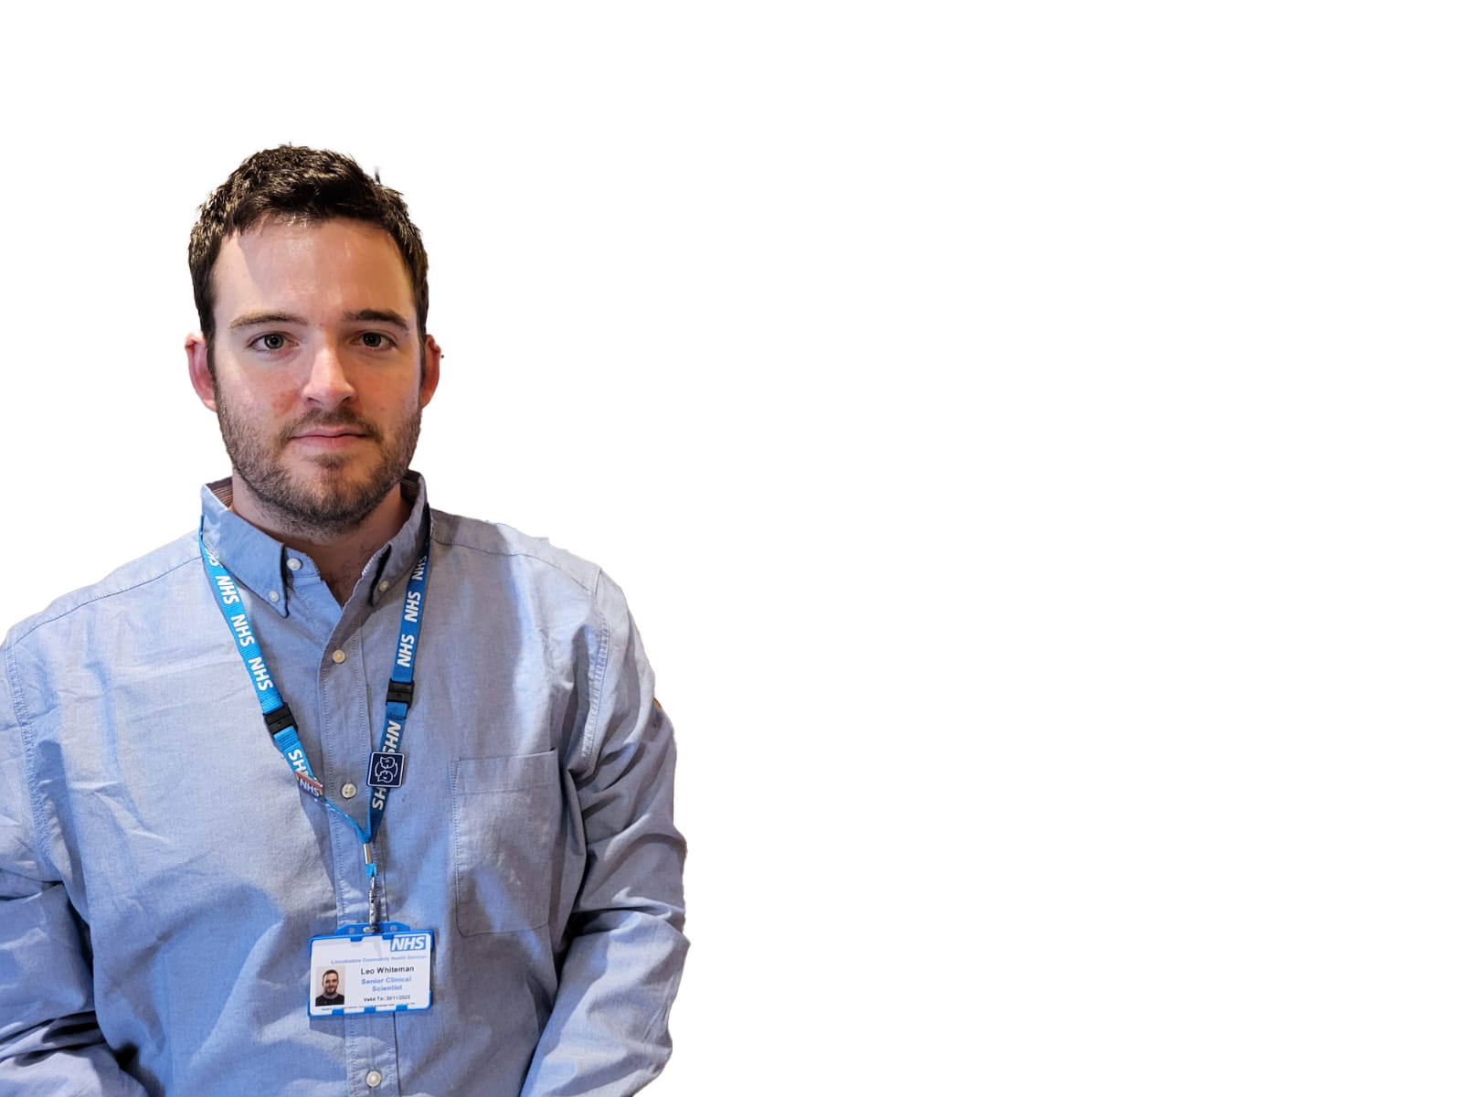
Meet Leo
What’s your job?
I’m a health scientist working for the NHS.
I make a difference by..
I design machines that help disabled people. Recently I helped a man use a tablet to talk, so he could speak to his wife again!
What I love about my job is..
When I’m helping people, I get to see how much my work helps their lives, affects their families and makes them smile
Why did you want to be an engineer?
Engineering is about designing things, problem solving and getting things done! You get to be creative, and your work really matters in society.
Find out more about Leo: https://neonfutures.org.uk/leo

Slide 5
Meet Charlotte
What’s your job?
I’m an agricultural engineer, working on farm.
I make a difference by..
I’m helping the UK reach net-zero by making farming equipment more efficient and better for the environment.
What I love about my job is..
I think the engineering behind farming is really interesting, and I also love working alongside all the animals.
Why did you want to be an engineer?
I really like making things, designing things and fixing things! Engineering lets me do that, working on tractors on the farm.
Find out more about Charlotte: https://neonfutures.org.uk/charlotte

Slide 6
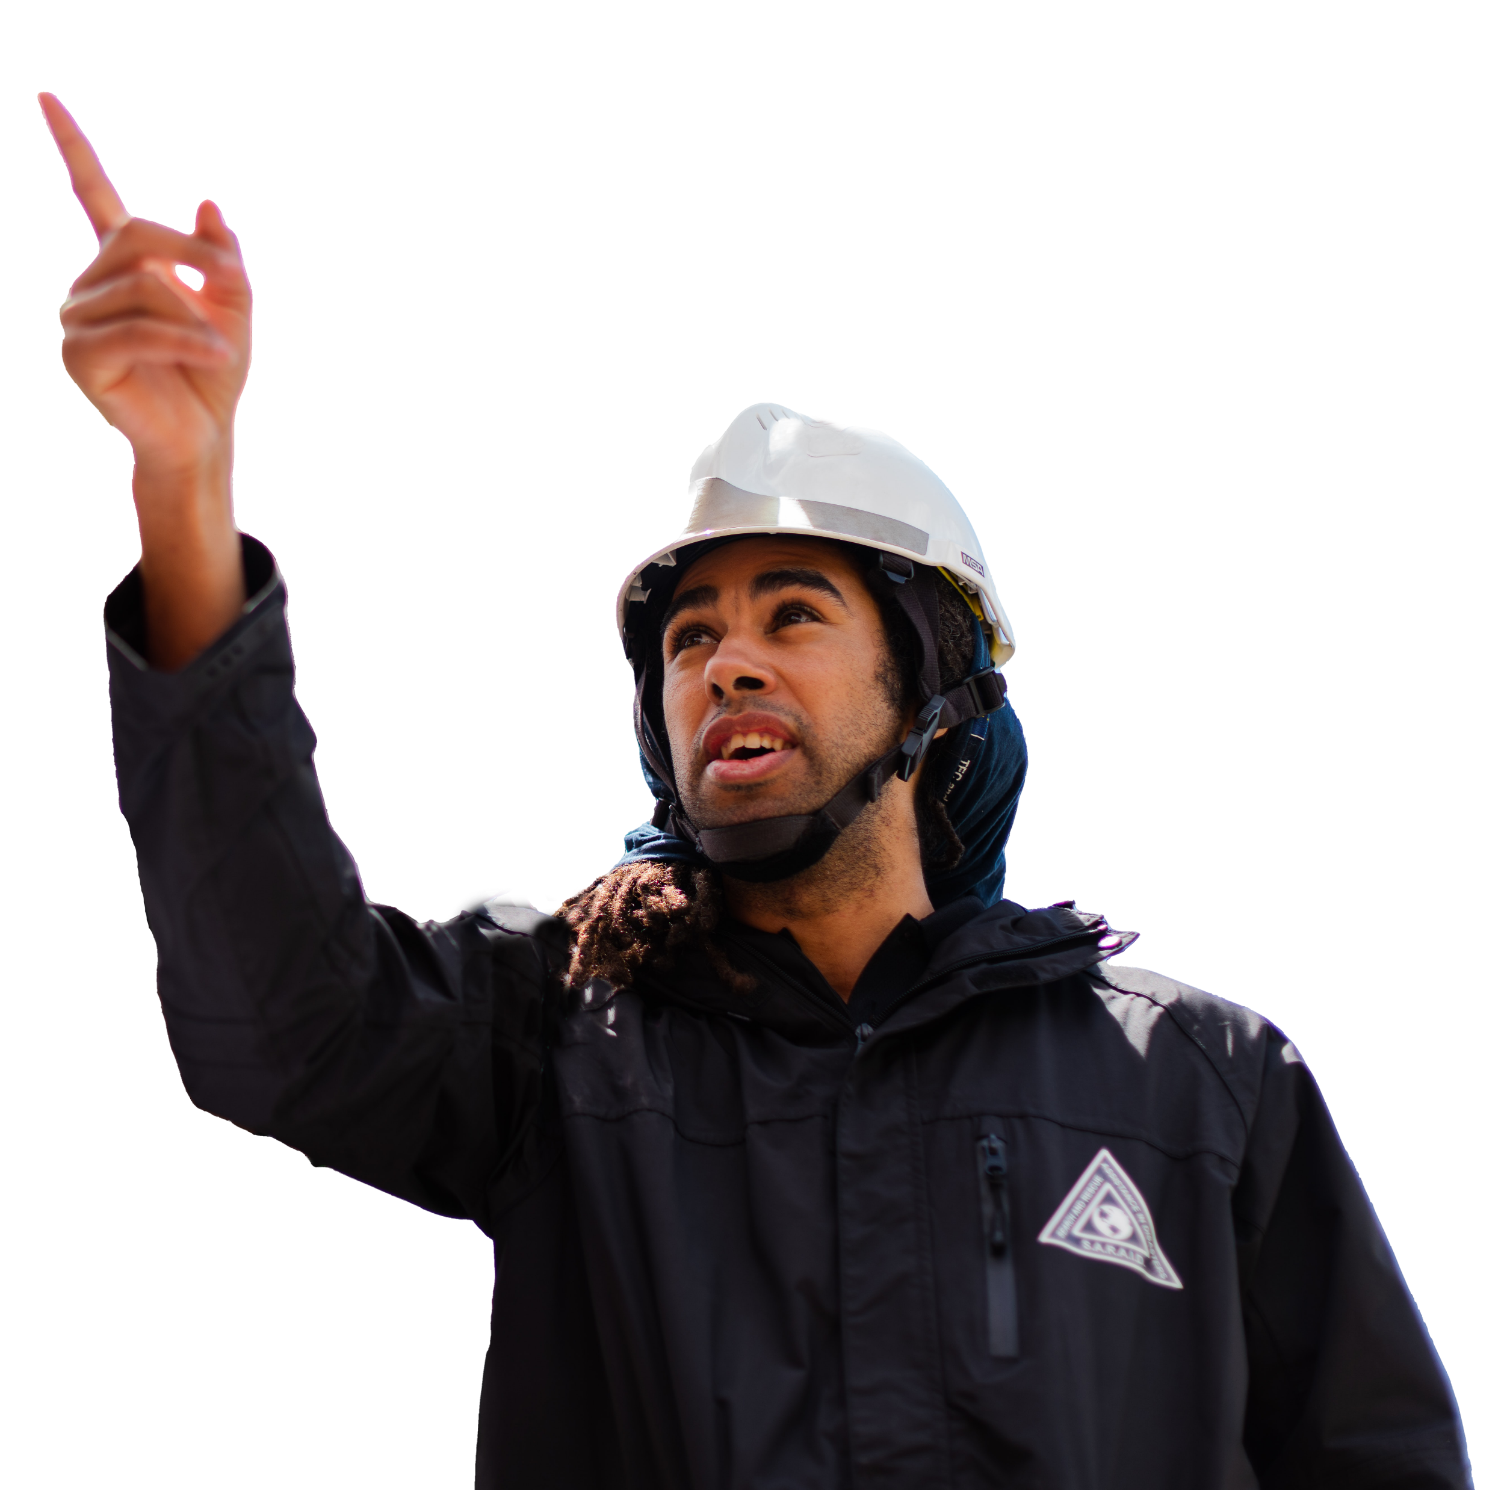
Meet Joshua
What’s your job?
I’m a research engineer, and I study tsunamis and natural disasters
I make a difference by..
My work helps reduce the impact of tsunamis by designing better sea defences and tsunami-resistant buildings.
What I love about my job is..
I enjoy working on real projects around the world which have a direct impact on people’s lives and society.
Why did you want to be an engineer?
I loved maths and science at school. I was so excited when I found out that engineers can help save and improve people’s lives.
Find out more about Joshua: https://neonfutures.org.uk/joshua

Slide 7
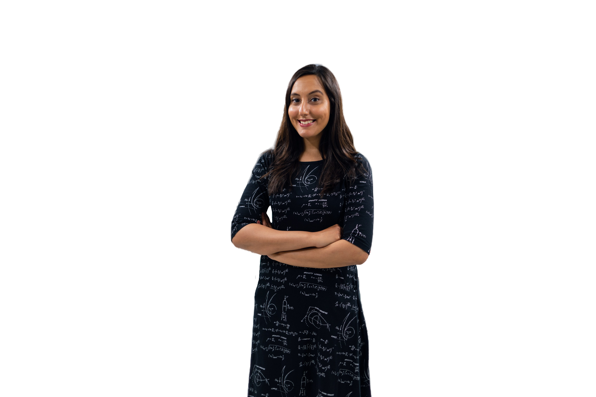
Meet Vinita
What’s your job?
I’m a space engineer at the European Space Agency.
I make a difference by..
I help train astronauts get ready to go into space, to make sure they’re ready to work on the International Space Station.
What I love about my job is..
I love being able to inspire more girls to work in space engineering. I’ve met so many amazing people, and get to meet women all around the who go into space!
Why did you want to be an engineer?
When I was six, I learnt that the first British astronaut, Helen Sharman, flew into space. After that I knew that I wanted to work in space engineering. And now I do - I even recently worked with British astronaut Tim Peake!
Find out more about Vinita: https://neonfutures.org.uk/vinita

Slide 8
www.neonfutures.org Find us on Facebook Say hello on Twitter

